Slide 1
Project Tortoise
Object Detection framework
Biweekly Update 4

Slide 2
AGENDA
Project Progress and Summary
Dataset Overview
Training Pipeline
Performance Metrics
Training Analysis
Challenges and Solutions
Future Plans and Key Takeaways
Q&A

Slide 3

Project Progress and Summary
Dataset Filtering
300 classes -> 50 classes for efficiency
Updated Objects365.yaml to remove unnecessary categories
Training Optimizations
Tested multiple image sizes (640 vs 512)
Implemented multi-scale training for better adaptability
Fine-tuned hyperparameters
Performance Monitorying
Validation data used for tracking training progress

Slide 4
Dataset Overview

Slide 5
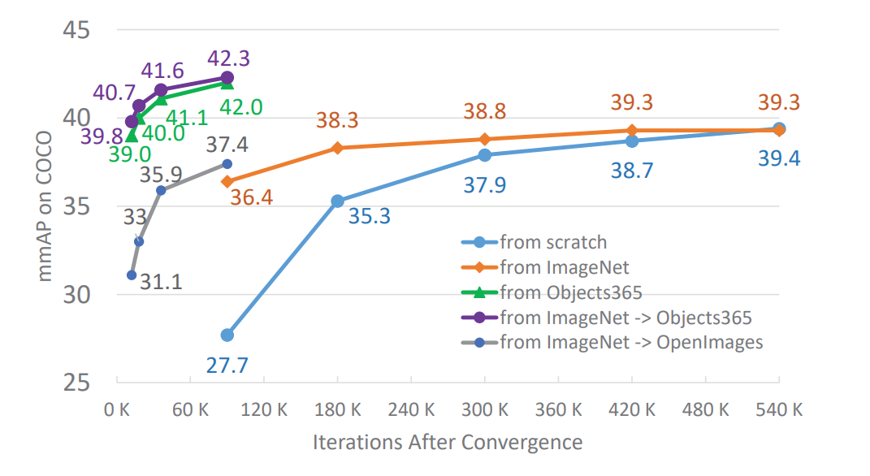
Dataset Overview
Summary
Objects365
365 categories, 600k+ images, millions of bounding boxes
Used for real-world object detection training
Filtering Process
Removed less relevant classes, focusing on mainly household objects
365 classes -> 50
Restructured dataset to improve efficiency and reduce training time
600k+ images reduced to only 10% of the original dataset
Original Paper Results
Results of finetuning COCO from ImageNet vs Objects365.
With a small number of iterations, 90K, for training, our Objects365 pre-trained model (green curve) can significantly outperform the algorithm finetuned from ImageNet (orange curve), even with much longer training time, e.g., 540K iterations. All results use a FPN based Resnet50 backbone (Shao et al)

Slide 6
Training Pipeline, Performance Metrics and Analysis

Slide 7
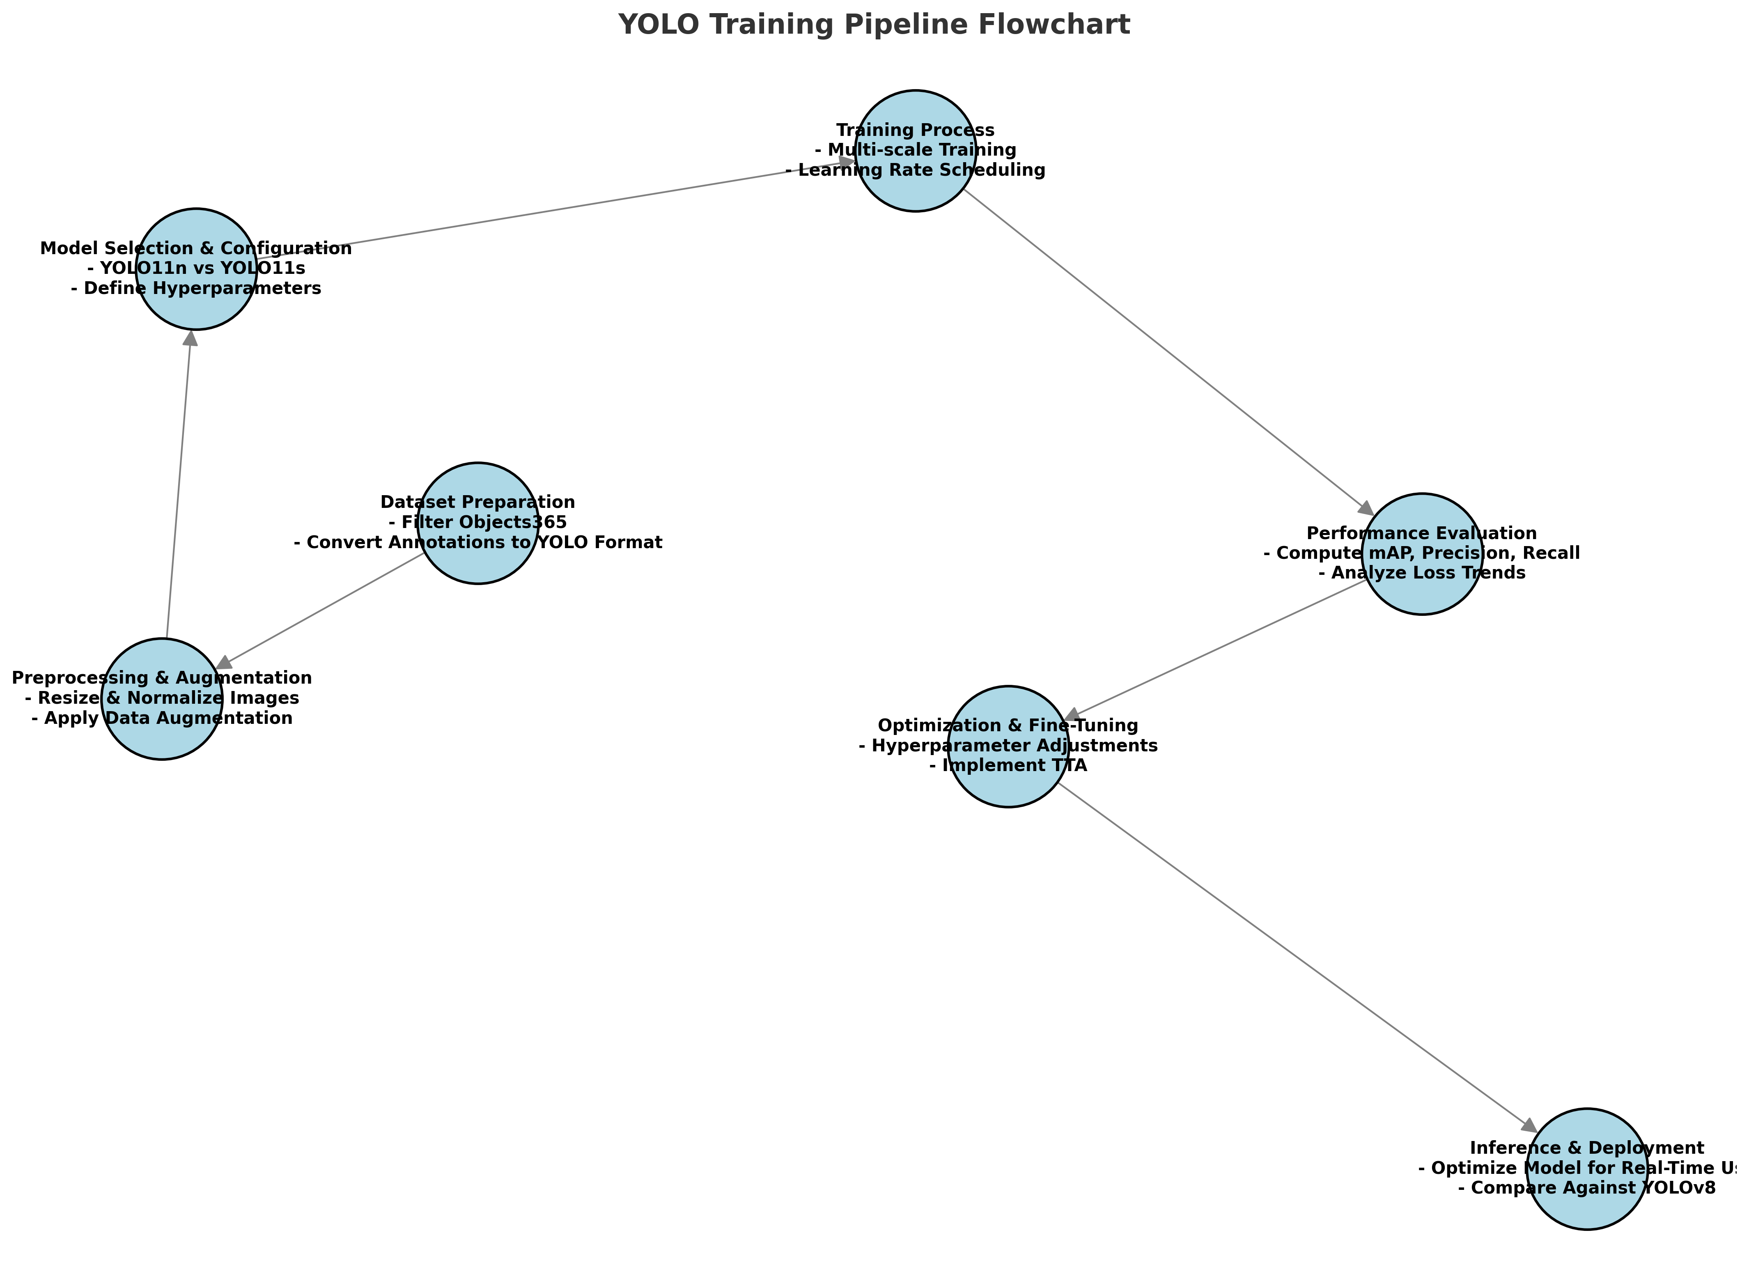
Training Pipeline
Breakdown
Pipeline Flowchart
Dataset Preprocessing
Data filtering and restructuring
Model Selection
YOLO11 Nano vs Small
Training Strategy
Image resizing, multi-scale training, batch optimzation
Performance Monitoring
mAP, Precision, Recall tracking

Slide 8
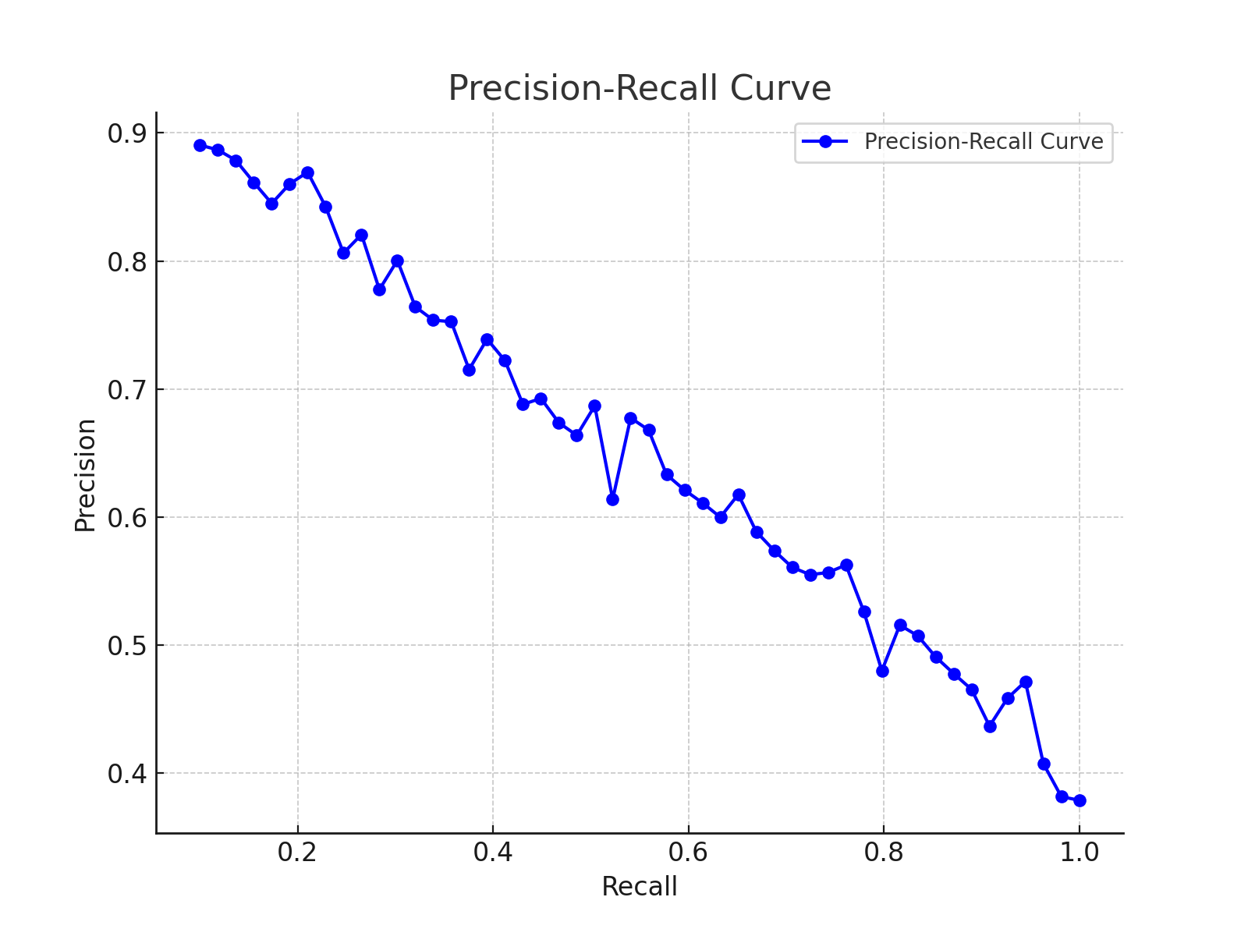
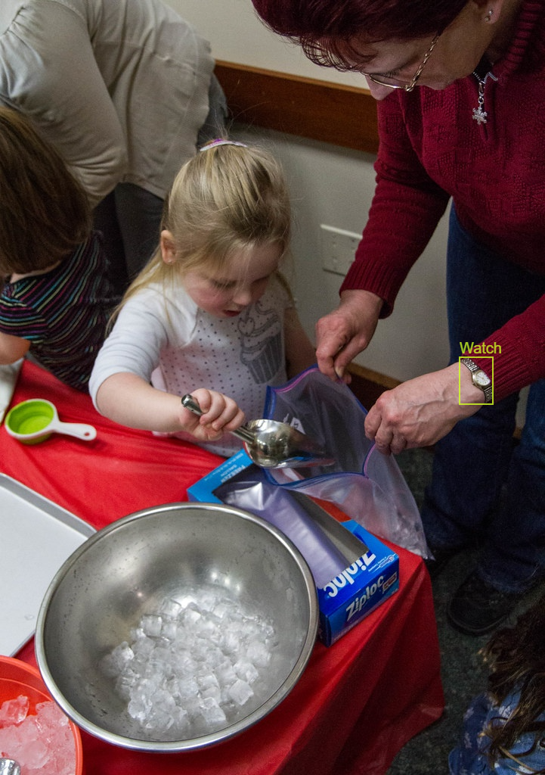
Performance Metrics
Metrics | YOLO11 | YOLO11 Tuned
mAP@50 | 0.5555 | 0.5970
mAP@50-95 | 0.4255 | 0.4500
Precision | 0.6187 | 0.6420
Recall | 0.6362 | 0.6580
F1-Score | 0.5458 | 0.5685
Massive improvements compared to previous dataset
Close to 15% improvement on scores
7.5% increase on individual model difference (YOLO8 -> YOLO11)

Slide 9
Performance Analysis
Key Analysis Points
Training/Loss Metric Graph
Training Stability
Training/Validation loss trends analyzed
Improvements from batch size & learning rate tuning
Training Time Reduction
Epoch times reduced by 20% using optimization and dataset filtering

Slide 10
Challenges and Solutions

Slide 11
Challenges and Solution
Challenges
Solutions
Long Training Times
High GPU Memory Usage
To deal with long training times…
Image Size reduced (640x640 -> 512x512)
Optimized Batch size (32 -> 16)
Epochs adjusted (150 -> 100)
To deal with high GPU memory usage…
Enabled mixed precision and multi-scale training
Mixed precision uses 16-bit/32-bit floating point precision to reduce memory usage and speed up computation
Multi-Scale Training randomly resizes input images to improve model robustness across different sizes

Slide 12
Future Plans and Key Takeaways

Slide 13
Future Plans and Key Takeaways
Summary of Progress
Summary Performance Metrics As Of Now
Successfully optimized YOLO11 on Objects365
Performance improved by 7.5% (mAP@50) after tuning
Overcoming challenges through preprocessing, augmentation and hyperparameter tuning
Metric | YOLO11 (Base) | YOLO11n | YOLO11s
mAP@50 | 0.5555 | 0.5971 | 0.615
mAP@50-95 | 0.4255 | 0.4522 | 0.4785
Precision | 0.6187 | 0.6423 | 0.6605
Recall | 0.6362 | 0.6584 | 0.6755
F1-Score | 0.5458 | 0.5685 | 0.5812
Training Time per Epoch | 12 mins | 9.5 min | 8 min

Slide 14
THANK YOU
Any questions?
Original Paper:
Objects365: A Large-scale, High-quality Dataset for Object Detection Shuai Shao, Zeming Li, Tianyuan Zhang, Chao Peng, Gang Yu, Jing Li, Xiangyu Zhang, Jian Sun ICCV

